Slide 1
Database Systems
CHAPTER 22
Database Recovery Techniques

Slide 2
Introduction
Recovery algorithms
Recovery concepts
Write-ahead logging
In-place versus shadow updates
Rollback
Deferred update
Immediate update
Certain recovery techniques best used with specific concurrency control methods

Slide 3
Recovery Concepts
Recovery process restores database to most recent consistent state before time of failure
Information kept in system log
Typical recovery strategies
Restore backed-up copy of database
Best in cases of extensive damage
Identify any changes that may cause inconsistency
Best in cases of noncatastrophic failure
Some operations may require redo

Slide 4
Recovery Concepts (cont’d.)
Deferred update techniques
Do not physically update the database until after transaction commits
Undo is not needed; redo may be needed
Example: (Log For Deffered Update)
<start_Transaction,T1>
<read_item,T1,A>
<write_item,T1,A,10>
<commit, T1>
Note: in deffered update we don’t need to store outdated value of data item because in this case we never undo any operation.
10 is the new value

Slide 5
Recovery Concepts (cont’d.)
Immediate update techniques
Database may be updated by some operations of a transaction before it reaches commit point
Operations also recorded in log
Recovery still possible.
Example: (Log For ImmediateUpdate)
<start_Transaction,T1>
<read_item,T1,A>
<write_item,T1,A,10,11>
<commit, T1>
10 is the old value
11 is the new value

Slide 6
Recovery Concepts (cont’d.)
Note: in immediate update we store outdated value first so that we can rollback to the initial value of data item and updated value is stored after the outdated value.

Slide 7
Recovery Concepts (cont’d.)
Undo and redo operations required to be idempotent
Executing operations multiple times equivalent to executing just once
Entire recovery process should be idempotent
Caching (buffering) of disk blocks
DBMS cache: a collection of in-memory buffers
Cache directory keeps track of which database items are in the buffers

Slide 8
Recovery Concepts (cont’d.)
Cache buffers replaced (flushed) to make space for new items
Dirty bit associated with each buffer in the cache
Indicates whether the buffer has been modified
Contents written back to disk before flush if dirty bit equals one
Pin-unpin bit
Page is pinned(1) if it cannot be written back to disk yet

Slide 9
Recovery Concepts (cont’d.)
Main strategies
In-place updating
Writes the buffer to the same original disk location
Overwrites old values of any changed data items
Shadowing
Writes an updated buffer at a different disk location, to maintain multiple versions of data items
Not typically used in practice
Before-image: old value of data item
After-image: new value of data item

Slide 10
Recovery Concepts (cont’d.)
Write-ahead logging
Ensure the before-image (BFIM) is recorded
Appropriate log entry flushed to disk
Necessary for UNDO operation if needed
UNDO-type log entries: include the old value (BFIM) of the item written by the operation since this is needed to undo the effects of the operations from the log.
REDO-type log entries: include the new value(AFIM) of the item written by the operation since this is needed to redo the effects of the operations from the log.

Slide 11
Recovery Concepts (cont’d.)
Steal/no-steal and force/no-force
Rules that govern when a page from the database cache can be written to disk
No-steal approach
Cache buffer page updated by a transaction cannot be written to disk before the transaction commits
Steal approach
Recovery protocol allows writing an updated buffer before the transaction commits
Each Page is a Candidate for being Replaced, if new pages need to be inserted to buffer, also dirty pages.

Slide 12
Recovery Concepts (cont’d.)
Force approach
All pages updated by a transaction are immediately written to disk after the transaction commits
No-force: Changes made by the transaction do not have to be written to disk immediately
Typical database systems employ a steal/no-force strategy
Advantage of “steal” is that it avoids need for very large buffer space to store all updated pages in memory
Advantage of “no-force” is that an updated page of a committed transaction may still be in the buffer when another transaction needs to update it, thus eliminating the I/O cost to write that page multiple times to disk and possible having to read it again from disk

Slide 13
Recovery Concepts (cont’d.)
Write-Ahead Logging (WAL) protocol for recovery algorithm requiring both UNDO and REDO
All log records pertaining to a page are written to disk before the page is overwritten on disk
BFIM of an item cannot be overwritten by its after image until all UNDO-type log entries have been force-written to disk
Commit operation of a transaction cannot be completed until all REDO-type and UNDO-type log records for that transaction have been force-written to disk

Slide 14
Checkpoints in the System Log and Fuzzy Checkpointing
Taking a checkpoint
Suspend execution of all transactions temporarily
Force-write all main memory buffers that have been modified to disk
Write a checkpoint record to the log, and force-write the log to the disk
Resume executing transactions
DBMS recovery manager decides on checkpoint interval
It may be measured in time – say, every ‘m’ minutes – or in the number ‘t’ of committed transactions since the last checkpoint

Slide 15
Checkpoints in the System Log and Fuzzy Checkpointing (cont’d.)
Fuzzy checkpointing
System can resume transaction processing after a begin_checkpoint record is written to the log
Previous checkpoint record maintained until end_checkpoint record is written

Slide 16
Fuzzy Checkpoint
Let us consider that in system the time of checkpointing is tcheck and the time of system crash is tfail. Let there be four transactions Ta, Tb, Tc and Td such that −
Ta commits before checkpoint.
Tb starts before checkpoint and commits before system crash.
Tc starts after checkpoint and commits before system crash.
Td starts after checkpoint and was active at the time of system crash.

Slide 17
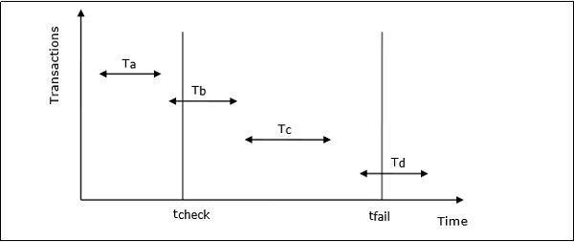
Fuzzy Checkpoint
The actions that are taken by the recovery manager are −
Nothing is done with Ta.
Transaction redo is performed for Tb and Tc.
Transaction undo is performed for Td.

Slide 18
Transaction Rollback
Transaction failure after update but before commit
Necessary to roll back the transaction
Old data values restored using undo-type log entries
Cascading rollback
If transaction T is rolled back, any transaction S that has read value of item written by T, similarly any transaction R that has read value of item written by S, and so on…, must also be rolled back
possible only when recovery protocol ensures recoverable schedules but does not ensure strict or cascade less schedule
Almost all recovery mechanisms designed to avoid this

Slide 19
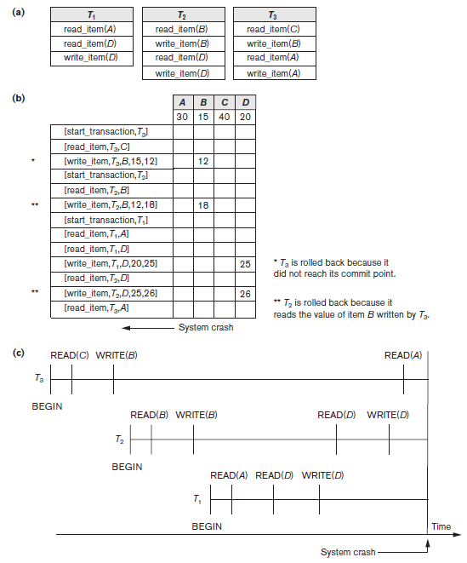
Figure 22.1 Illustrating cascading rollback (a process that never occurs
in strict or cascadeless
schedules) (a) The read and write operations of three transactions (b) System log at point of crash (c) Operations before the crash

Slide 20
Transactions that Do Not Affect the Database
Example actions: generating and printing messages and reports
If transaction fails before completion, may not want user to get these reports
Reports should be generated only after transaction reaches commit point
Commands that generate reports issued as batch jobs executed only after transaction reaches commit point
Batch jobs canceled if transaction fails

